Slide 1
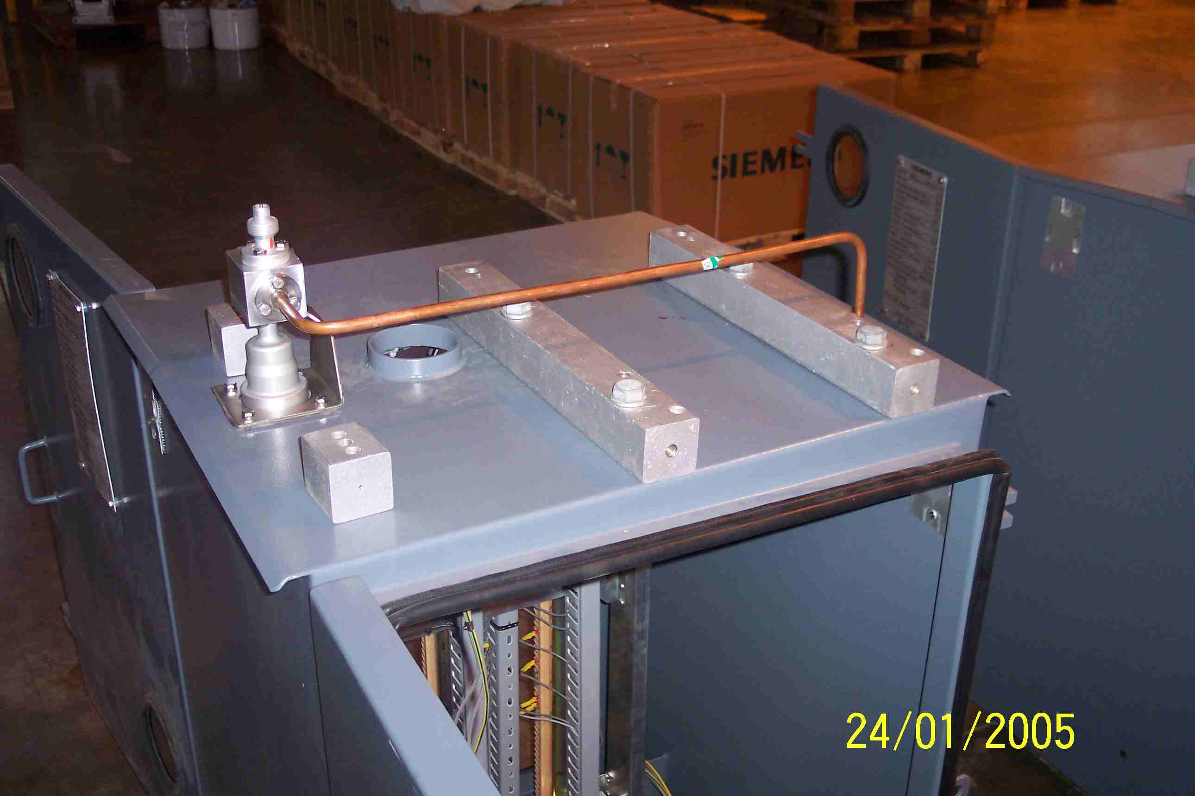
SIEMENS
HVCB SPARES
Small Gas pipe-1, 72.5KV, 31.5KA CB
S4713614701

